Slide 1
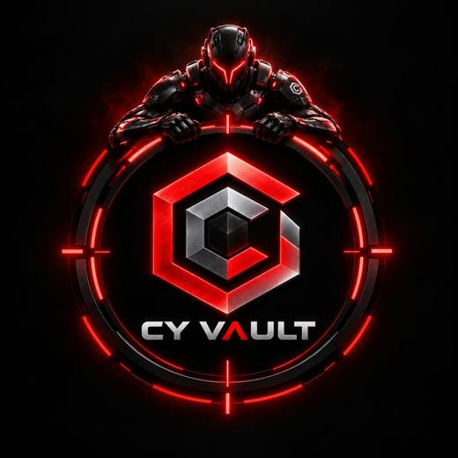
CyVault
Digital Risk Protection
Stop brand impersonation before your customers get hurt.
"There's no silver bullet in cybersecurity; only layered defense works."
14
sections
0-100
risk score
100%
in your browser

Slide 2



The problem
Scammers copy a brand to trick its customers
Fake websites
Copycat apps
Links and APKs
Look-alike domains with a zero for an o, or words like secure and kyc, steal OTPs and card details.
Fake apps with the brand name and logo ask for SMS and screen-control permissions.
Links and app files sent over SMS, WhatsApp and social media install malware.
Brands usually find out after customers have already lost money.

Slide 3






Our solution: CyVault
One tool, many layered checks, every score explained
Brand setup
Evidence Report
URL Scanner
Official handle, website and app form the allow-list.
Charts, searchable flagged items, CSV export.
Scores up to 10 links for scam signals.
APK Scanner
Logo Scanner
Honeypot AI
Static check of permissions, source and package.
Finds copied logos by shape, layout and colour.
Simulation: scammer sees a decoy balance.

Slide 4
Everything in CyVault
14 sections, each with one job
Login and themes
Brand
Evidence Report
App Monitoring
Sign up, demo user, light and dark mode.
Official handle, website, app and logo form the allow-list.
Charts, flagged items table, CSV export, check history.
Ranked copycat apps; report a fake app.
Websites and Report
URL Scanner
APK Scanner
Logo Scanner
Look-alike domains; report a fake website.
Scores up to 10 links for scam signals.
Static check of permissions, source and package.
Compares a logo with yours by shape, layout, colour.
Scam Alerts
Honeypot AI
Risk Dashboard
Check
Six scam types with warning signs and safety tips.
Simulation: decoy balance and evidence log for scammers.
All stats in one place, plus a PDF report.
Quick domain lookup, saved to history.
Architecture
AI Chat
Seven-step view of how CyVault works.
Ask about scams and threats by typing or voice.

Slide 5
How it works
Weighted signals add up to a score from 0 to 100 with reasons
1 Brand profile
2 Detection
3 Score
4 Outputs
>
>
>
Official assets score 0
Name, domain, permissions, logo, source
Weighted signals, reasons shown
Takedown report, PDF, AI chat
Risk levels
Low
0 - 29
Medium
30 - 59
High
60 - 79
Critical
80 - 100

Slide 6



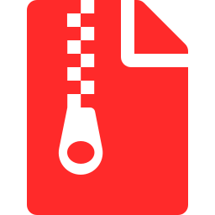


Technology
Plain web technologies, everything runs in the browser
HTML, CSS, JS
Web Crypto
Canvas
Single file, no framework, light and dark theme
Salted SHA-256 password hash, APK fingerprint
Logo comparison by shape, layout, colour
DecompressionStream
Web Speech API
localStorage, Netlify
Reads APK files without uploading them
Voice input and spoken replies in AI Chat
Saves data in the browser, hosted as a static page
No backend. No data leaves the user's device.

Slide 7
Thank you
Pause before you click. Never share your OTP. Scammed in India? Call 1930.
TEAM CYVAULT
Rupa
Teja Gayatri
Manikanta
Goutham
Trilok
cy-vault.netlify.app/cyvault-v5.html

